Slide 1
Activity Insight
Overview and Start Up Guide

Slide 2
About Activity Insight
Activity Insight is a customizable online information management system designed to organize and report on faculty teaching, research and service. It will replace the existing CV system that is currently available in the HS Portal.

Slide 3
Getting Started
https://www.digitalmeasures.com/login/nova/faculty/authentication/showLogin.do
Or www.business.nova.edu
Go to Faculty and Staff Resources, Technology, Activity Insight
Click Need Help?
Click Reset Your Password – make sure you enter your NSU email address
A link will be sent to your email account (must be NSU).
Follow the directions to set up your password for first time access.
Choose a password you will remember. Activity Insight uses local authentication, meaning they do not authenticate off NSU servers.
If at any time you forget your password, you can always use the Reset Your Password option

Slide 4
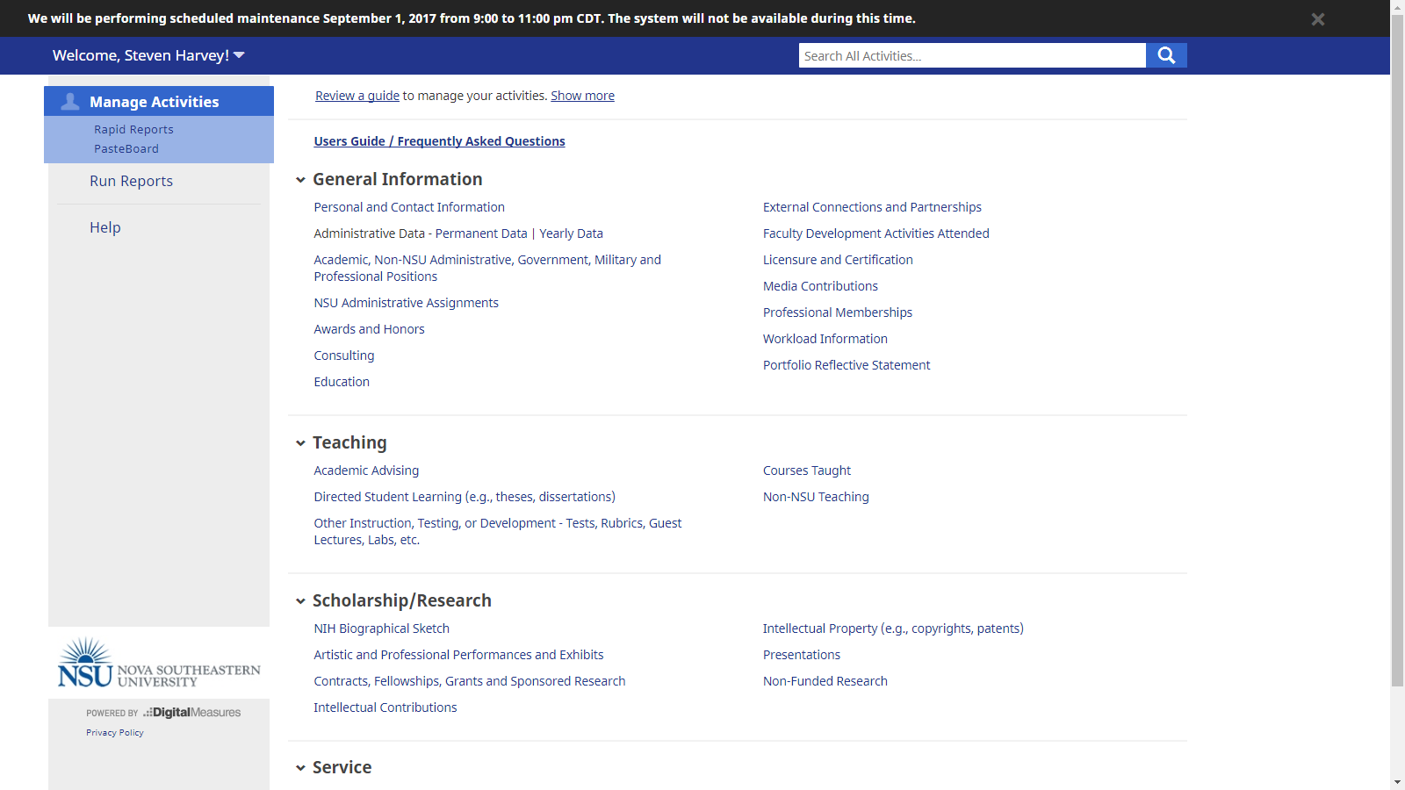

Slide 5
Manage Activities – Your Homepage
On your homepage, you have access to many screens that allow you to enter in various types of activity, service and research. We encourage you to explore all areas. The next screen will show you what areas you should not edit. Unfortunately because we share a University license, we cannot lock areas for just the HCBE. Help us keep our data accurate by not editing or altering the following areas…

Slide 7
Yearly Data – Don’t EdiT
The information in the Yearly Data screen drives a number of our official and accreditation related reports. Altering information in here could result in inaccuracies in our reports. If you have a concern over any data in the Yearly Data screen please contact Raejean Tanyar at raejeanf@nova.edu to discuss.

Slide 8
Courses Taught – Don’t Edit Course Information
While many of the items on the Courses Taught screen are locked, you have access to the Course Level and AACSB Degree Program boxes.
Please Do Not alter or edit these two fields.
They are critical to our reporting.
You can enter or update any information from the New Course Preparation item and below and
Please enter any teaching innovations, new teaching materials developed or enhanced learning opportunities for your courses.
It shows the IMPACT of your teaching!

Slide 9
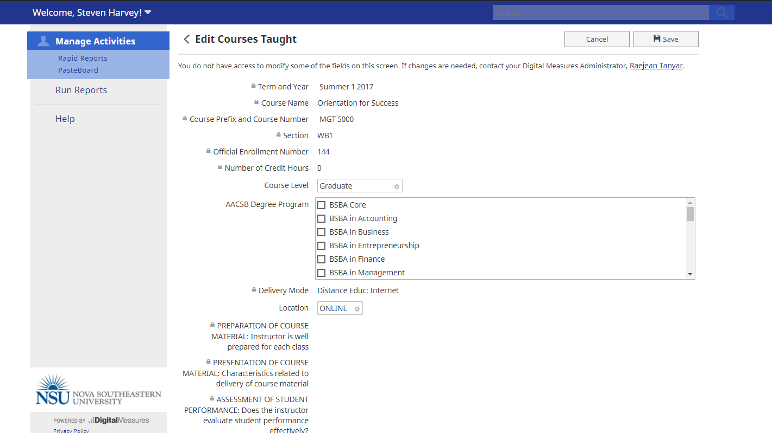
Do not edit
Course level or
AACSB Degree Program

Slide 10
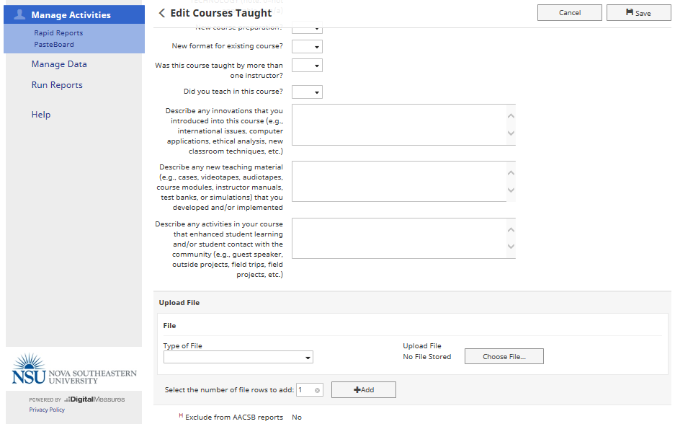
Please enter any innovations, new teaching materials & course enhancements here
Demonstrates
Impact of your teaching!

Slide 11
Reports – What can they do for you?
As you build and add more information to Activity Insight, you will find the reporting tool to be far more useful. The reports available are:
Course and Evaluation Report – this report details all courses taught in the reporting period
NIH Biographical Sketch – used by HPD Only
Portfolio Report – this pull all data in Activity Insight into one report. This is the preferred CV/Vita report for HCBE.
Vita – not preferred for HCBE as it has many screens that are specific to HPD and would need to be manually removed by the faculty member

Slide 12
Data Integration
We are continually looking for ways to integrate data from the various NSU systems into Activity Insight.
Right now:
Courses Taught is a quasi-automated process.
Under the old Course Evaluation System, course evaluations were automatically integrated. However the IDEA system has limitations that prevent us and HPD from automating the information transfer.
We will keep working for ways to pull in as much information from Banner, IDEA, NSU Works and other NSU systems wherever possible.

Slide 13
Upcoming Features
Customizable CV – Expected – Fall 2017
This new option within Run Reports empowers faculty to use their Activity Insight data to create customized CV’s for their various purposes. Formatting and editing capabilities ensure each custom CV meets the faculty member’s exact needs.
Workflow – Expected – Spring 2018
Workflow is the solution for digitizing and managing faculty processes such as faculty review, promotion and tenure and annual evaluations.

